Slide 1

Predictive Analytics for Business Decision Making
Team Members:
Yash Patel
Akshar Barot
Saumil Trivedi
Jayanth Kumar
Bibek Kandel

Slide 2

Understanding the Business Problem
The core business problem we address is customer churn, a critical issue affecting profitability across industries. Customer churn refers to the rate at which customers stop doing business with a company.
Decreased Revenue
Increased Acquisition Costs
Negative Brand Impact

Slide 3
Dataset: Telco Customer Churn Analysis
To analyze the problem, we leverage the "WA_Fn-UseC_-Telco-Customer-Churn.csv" dataset(Kaggle), a valuable resource containing information about telecom customers and their churn behavior. Target variable is 'Churn' indicating if a customer has left the service.
Customer Demographics
Service Usage
Billing Information
Gender, senior citizen, partner,
dependents
Tenure, internet service, contract
Monthly charges, total charges, payment method
Total records
7043
Dataset Link:
https://www.kaggle.com/datasets/palashfendarkar/wa-fnusec-telcocustomerchurn?

Slide 4

Data Cleaning and Preparation
Before building our predictive model, it's crucial to clean and prepare the data. This involves addressing missing values, handling inconsistent data types, and transforming variables into a suitable format.
1
Drop customerID
2
Convert TotalCharges to Numeric
Removes unique identifier not relevant for prediction.
Ensures compatibility with machine learning algorithms.
3
Impute Missing Values
Replaces missing data with the median to preserve sample size.

Slide 5

Model: Random Forest with Hyperparameter Tuning
We employed a Random Forest model, a powerful ensemble learning technique known for its accuracy and robustness. To optimize the model's performance, we conducted hyperparameter tuning using Grid Search.
1
Model Selection
Chosen for accuracy and robustness.
2
Hyperparameter Tuning
Optimized with Grid Search.
3
Feature Visualization
Identified Important Features

Slide 6
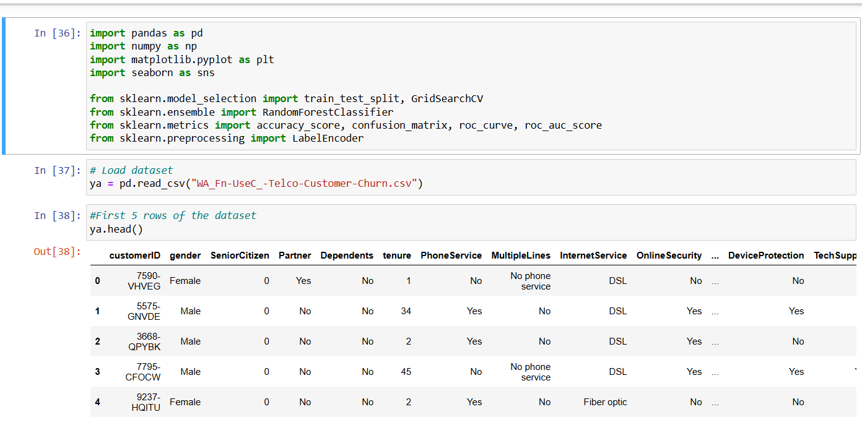
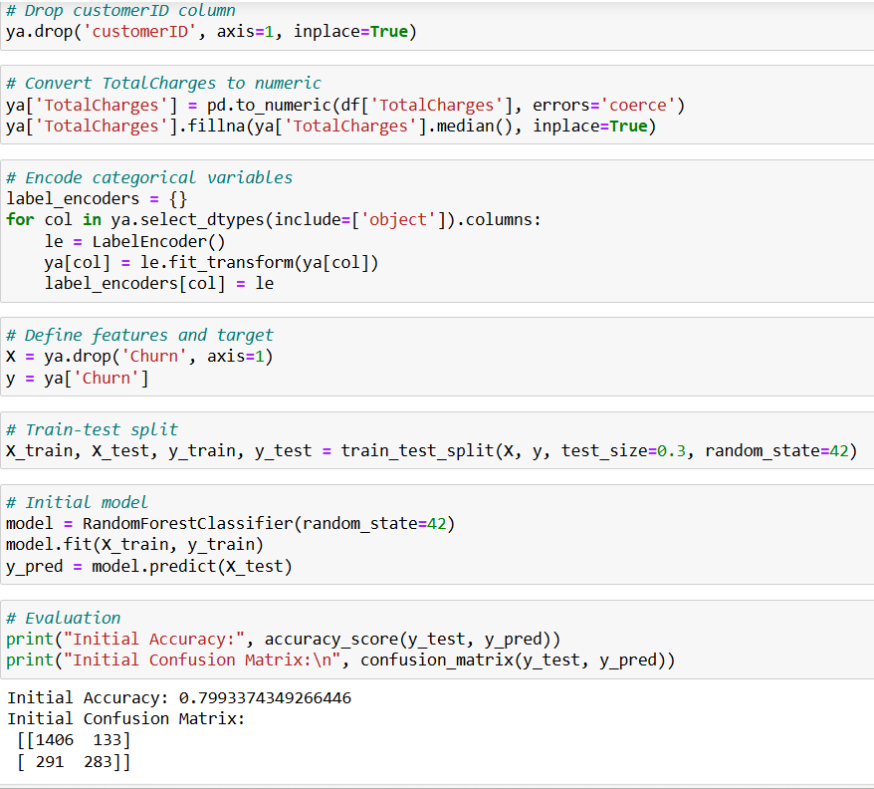
Model Implementation( Code Snapshot)

Slide 7
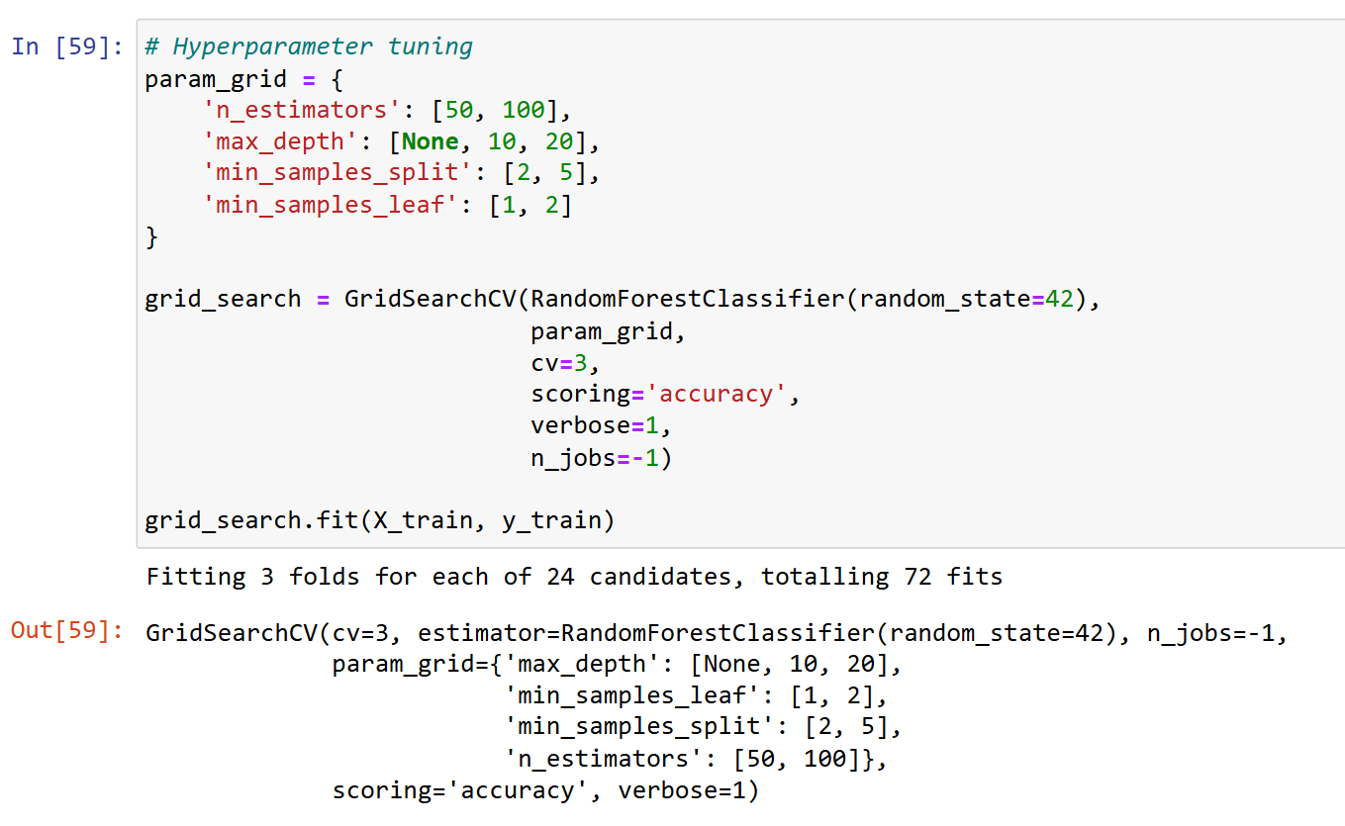
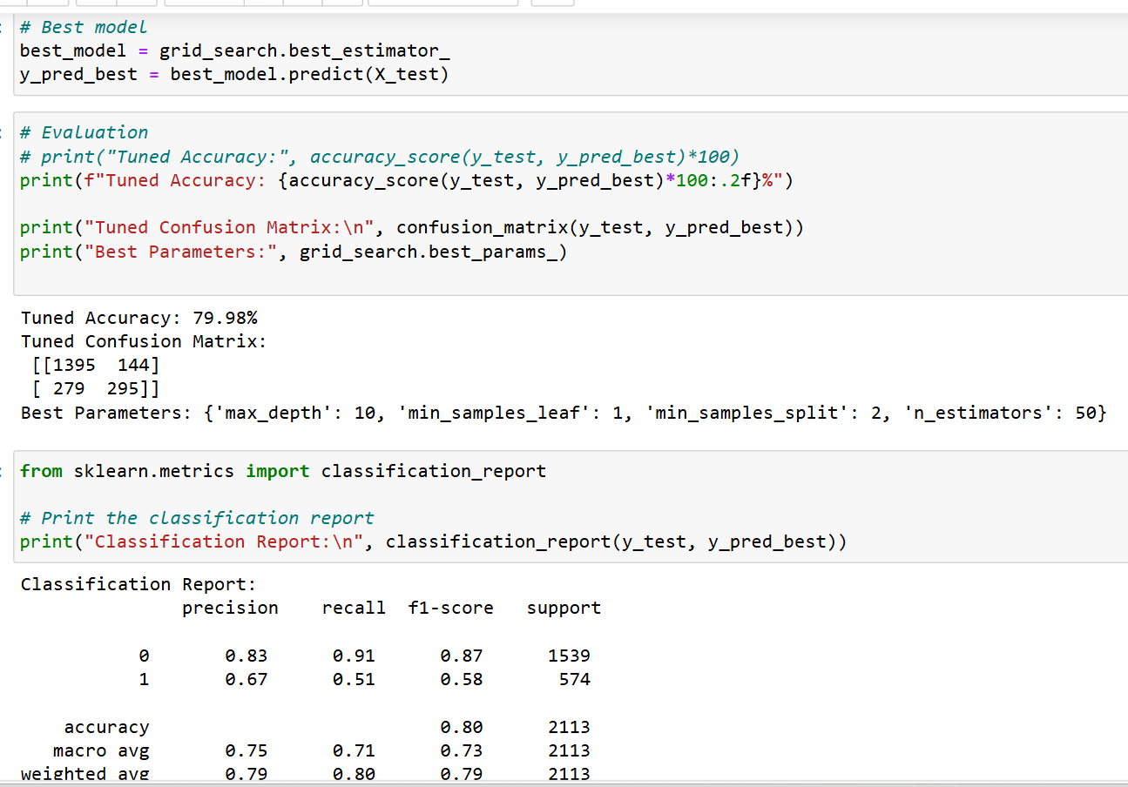
Model Implementation( Code Snapshot)

Slide 8
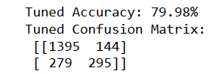
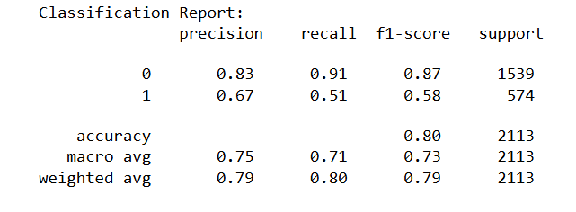
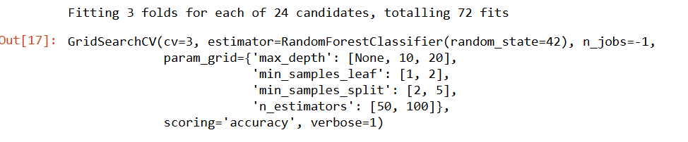
Results and Evaluation
The Random Forest model achieved a high level of accuracy in predicting customer churn. Key performance metrics such as precision, recall, and F1-score were evaluated to assess the model's effectiveness.
79.98%
67%
Accuracy
Precision
Overall correctness of predictions.
Ability to avoid false positives.
51%
Recall
Ability to identify churners.

Slide 9
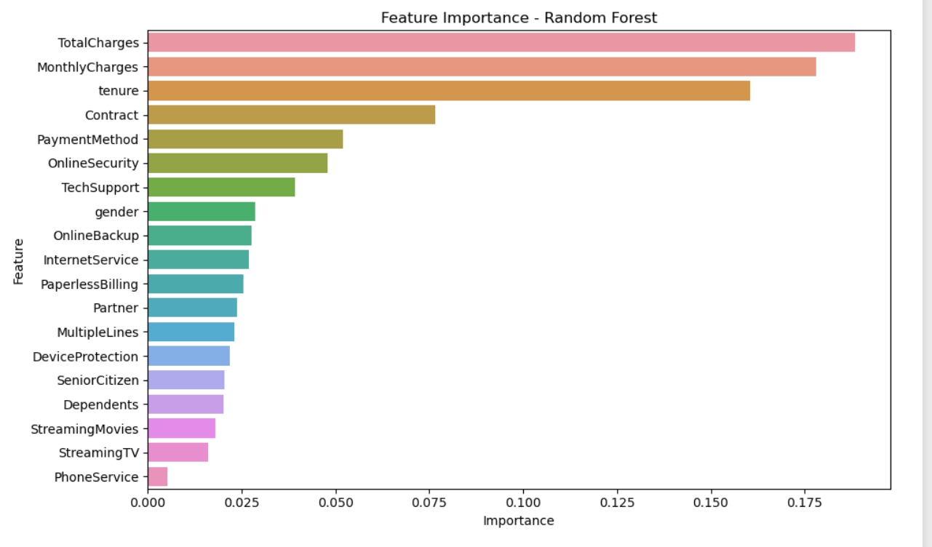
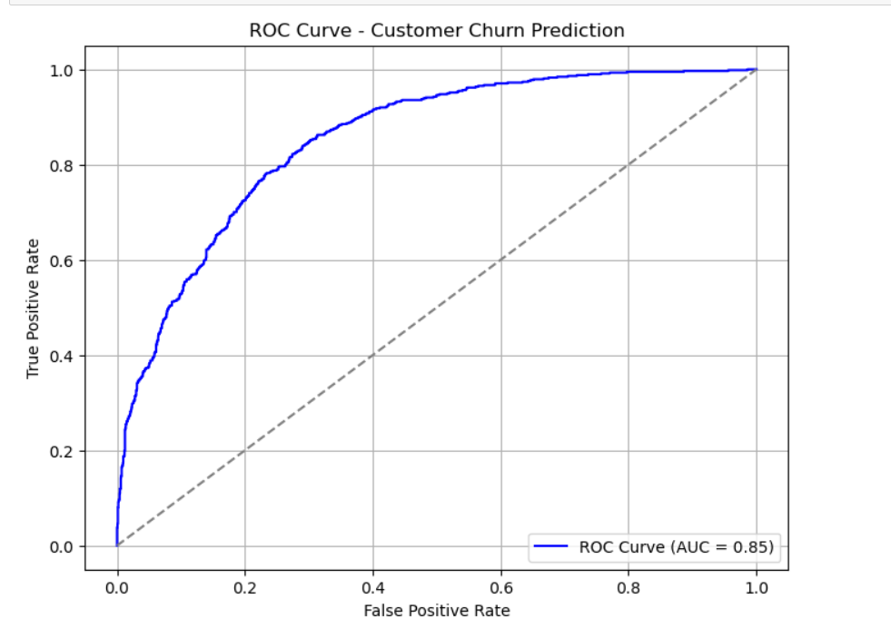
Results

Slide 10
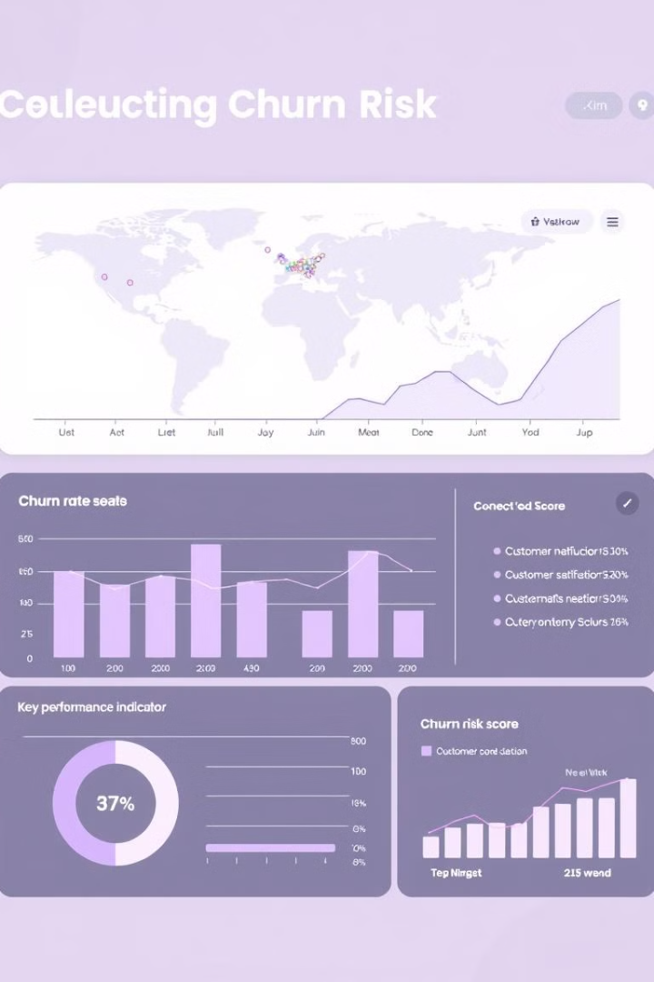
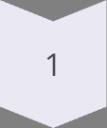
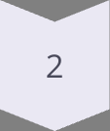
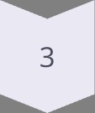
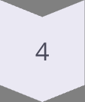
Interpretation and Recommendations
The results reveal several key factors driving customer churn.
• Key drivers of churn include TotalCharges, MonthlyCharges, tenure, and Contract type.
• Customers with short tenure and month-to-month contracts are more likely to churn
Addressing these key drivers can significantly reduce churn rates and improve customer loyalty.
Shorter Contracts
Offer longer-term incentives.
Higher Monthly Charges
Provide discounted rates.
Specific Service Usage
Personalize service plans.
Proactive Support
Improve customer experience.

Slide 11

Key Takeaways and Next Steps
Predictive analytics converts data into actionable insights, enabling companies to make better decisions and minimize customer churn. Through the identification of the most important churn drivers, companies can develop focused retention initiatives and continually update their models with fresh data.
Deploy Model
Integrate into business processes.
Monitor Performance
Track accuracy and effectiveness.
Refine Model
Continuously improve based on new data.

Slide 12
Conclusion
Random Forest model had an accuracy of approximately 80% showing stable performance in customer churn prediction.
The precision of the model is 67%, while recall is 51%, meaning the model has better precision than recall in avoiding false positives rather than detecting all the customers who will churn.
An AUC of 0.85 indicates strong classification power.
TotalCharges, MonthlyCharges, tenure, and Contract type are the key drivers of churn.
Although the parameter tuning provided improved results, further recall improvement can still be achieved by experimenting with different models or additional feature engineering.
.
.

Slide 13
References
https://ieeexplore.ieee.org/document/10724574
https://ieeexplore.ieee.org/document/10531735
https://doi.org/10.1016/j.ejor.2008.06.027
https://doi.org/10.1287/mksc.2020.1229
https://www.sciencedirect.com/science/article/pii/S2667096825000138
.
.

